Slide 1
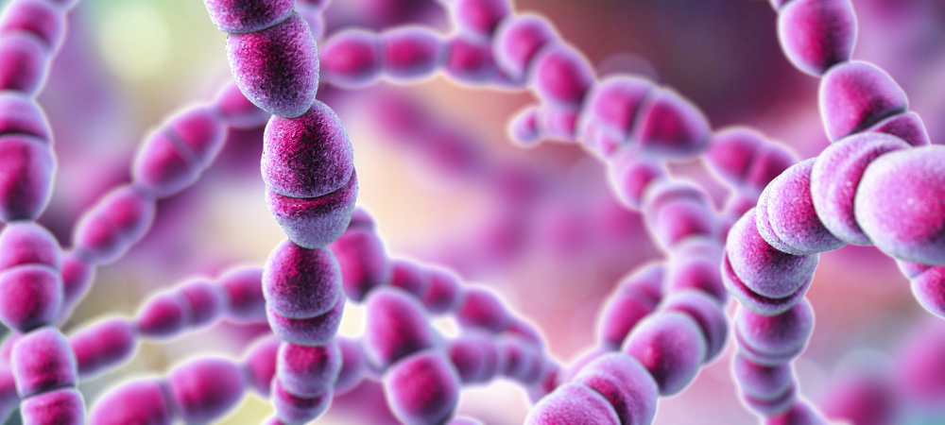
Group A Streptococcus: A Novel Vaccine Design
Group A Streptococcus (GAS)
(Streptococcus pyogenes)
Freya Ellis, Sophie Pryal, Sophie Fisher

Slide 2
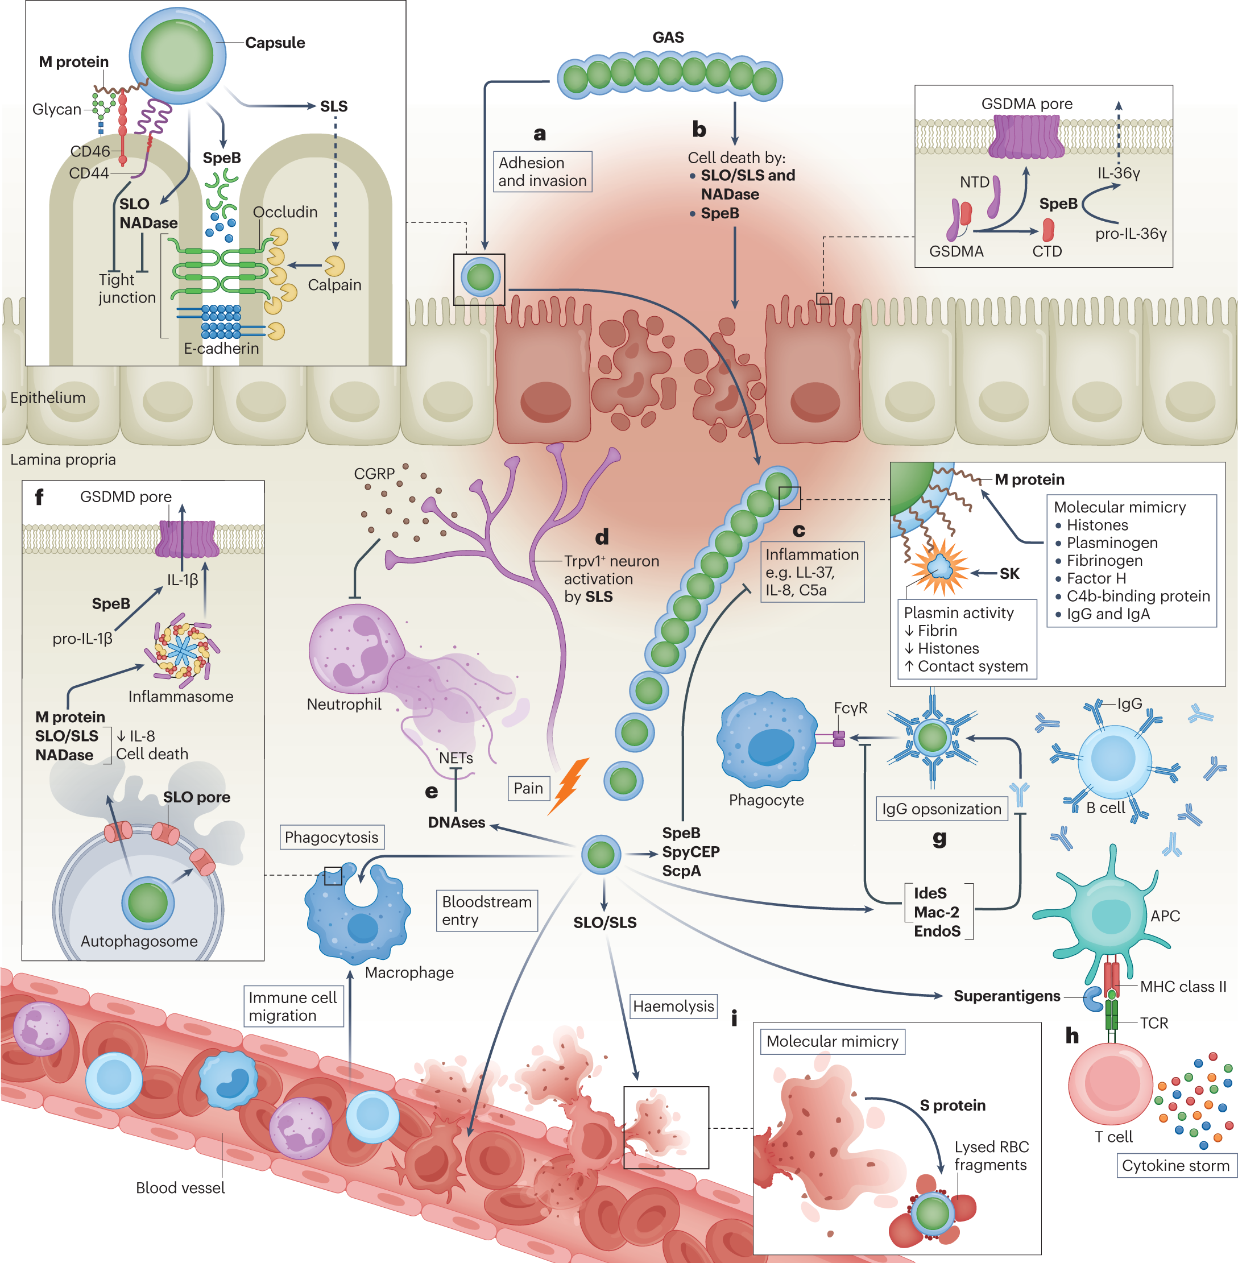
Pathogenesis of Group A Streptococcus (Streptococcus pyogenes)
Causes infections of the throat, skin and soft tissue.
Mild:
Strep throat, pharyngitis, scarlet fever, impetigo, cellulitis.
Severe:
Necrotising fasciitis, necrotising pneumonia, Rheumatic fever
The bacterium possesses a range of virulence factors:
M protein
Hyaluronic acid capsule
Toxins SpeB, SLS and SLO
SpyCEP
Superantigens
(Brouwer et al., 2023)

Slide 3

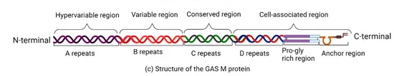
Proposed solution: choice of antigen epitopes
Our Solution: a novel multi-epitope mRNA vaccine
Example mRNA construct:
Not targeting the hypervariable region
J8.12 = optimized variant of J8 in conserved region
Targeting
adhesion
& invasion
Peptide also from C-region of M-protein
Involved in immune evasion mechanisms
Highly conserved across serotypes
Non-M-protein antigen
Highly conserved across GAS strains
Stimulates neutrophil response, reducing virulence
(Fan et al., 2024)
Using J8 epitope (present in 79% of GAS isolate emm genes globally)

Slide 4
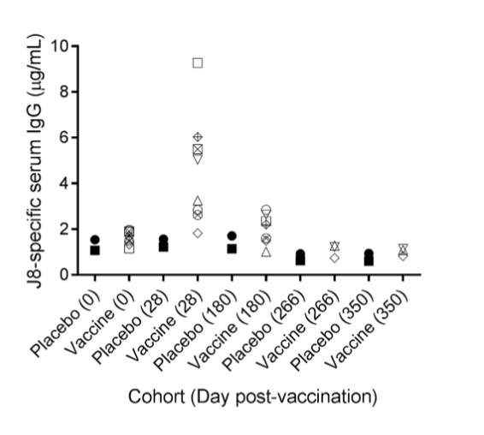
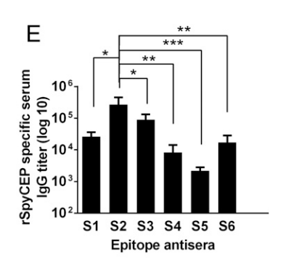

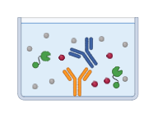
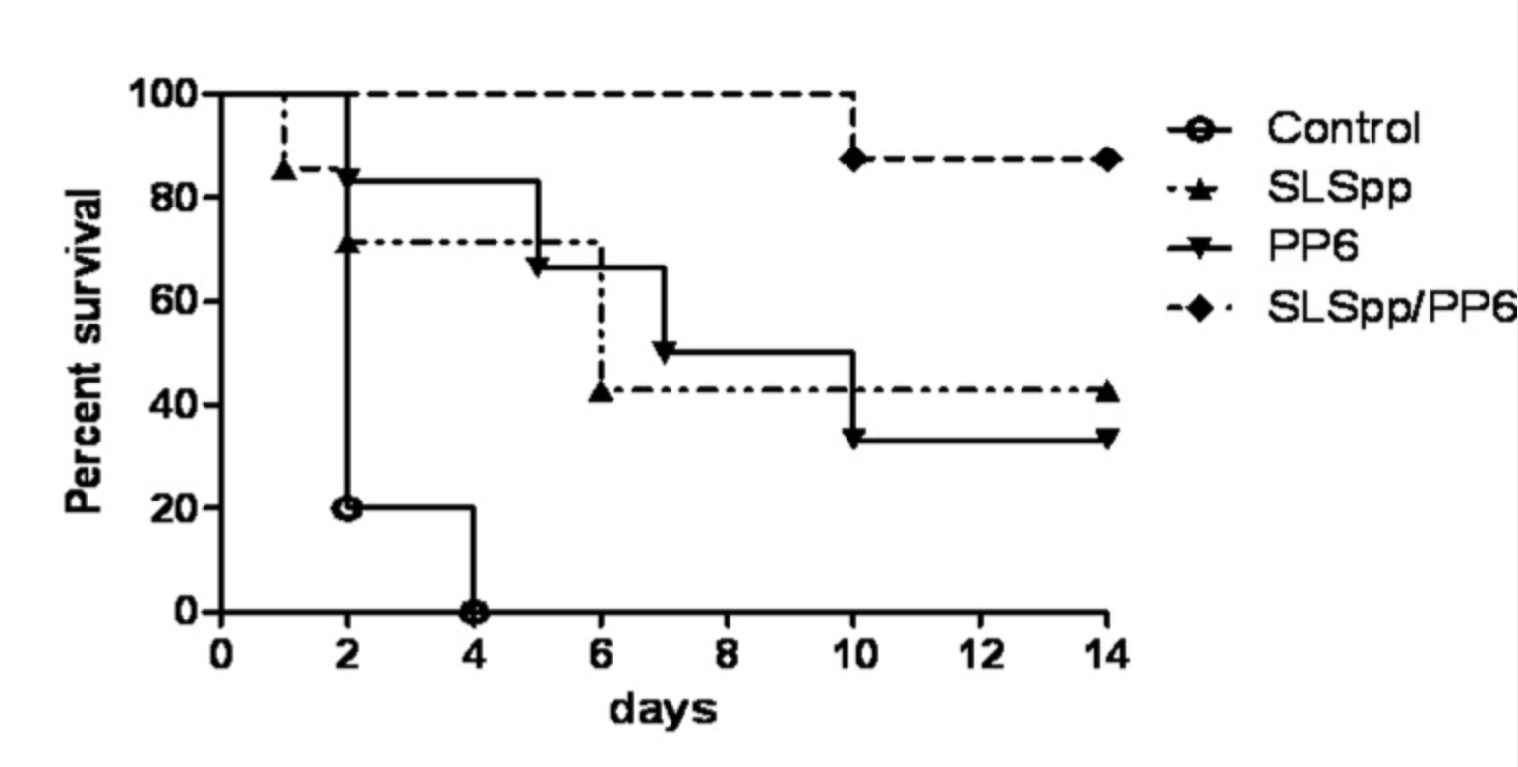

Correlates of protection
Correlates of Protection =
A measurable immune marker that predicts protection against infection
Related assays predicting protection by J8.12, C3 and SpyCEP epitopes:
Vaccine day 28
Highest in S2 epitope
No established correlates of protection for GAS
Useful in testing vaccine efficacy
No standardised immunoassays for GAS
Makes vaccine development challenging
(Sekuloski et al., 2018)
(Pandey et al., 2016)
Anti-J8 IgG serum levels in MJ8VAX (phase I clinical trial)
Anti-SpyCEP IgG levels in peptide vaccine
Synergistic effects when epitopes are combined
(Kuo et al., 2015)
% Survival after immunization (PP6 = C3 epitope)

Slide 5
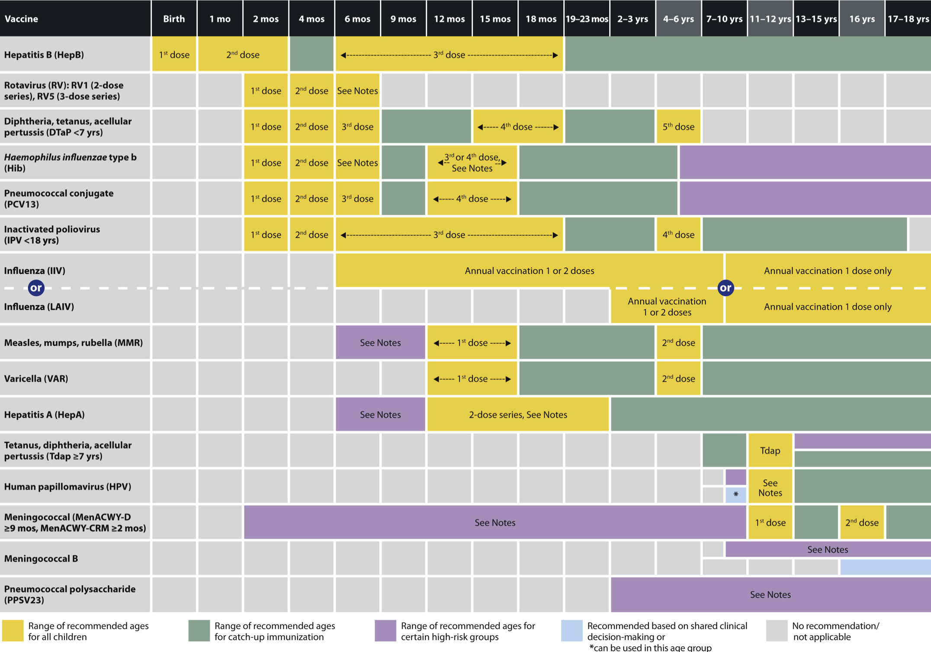
Reason for dosing regime
1st , 2nd & 3rd dose align with 6 in 1 vaccine
Mucosal booster administered at 4-5 y/o alongside DTaP
Allows for:
Efficiency
Safety and Familiarity
Enhanced protection
(CDC, 2024)

Slide 6
References
Tsoi, S.K., Smeesters, P.R., Frost, H.R.C., Licciardi, P. and Steer, A.C. (2015). Correlates of Protection for M Protein-Based Vaccines against Group A Streptococcus. Journal of Immunology Research, 2015, pp.1–11. doi:https://doi.org/10.1155/2015/167089.
UK (2023). Vaccination of individuals with uncertain or incomplete immunisation status: from 1 September 2024. [online] GOV.UK. Available at: https://www.gov.uk/government/publications/vaccination-of-individuals-with-uncertain-or-incomplete-immunisation-status/vaccination-of-individuals-with-uncertain-or-incomplete-immunisation-status-from-1-september-2023#download-print-copies.
Vannice, K.S., Ricaldi, J., Nanduri, S., Fang, F.C., Lynch, J.B., Bryson-Cahn, C., Wright, T., Duchin, J., Kay, M., Chochua, S., Van Beneden, C.A. and Beall, B. (2019). Streptococcus pyogenes pbp2x Mutation Confers Reduced Susceptibility to β-Lactam Antibiotics. Clinical Infectious Diseases, 71(1), pp.201–204. doi:https://doi.org/10.1093/cid/ciz1000.
Walker, M. J., et al. “Disease Manifestations and Pathogenic Mechanisms of Group a Streptococcus.” Clinical Microbiology Reviews, vol. 27, no. 2, 1 Apr. 2014, pp. 264–301, https://doi.org/10.1128/cmr.00101-13.
World Health Organization. “Rheumatic Heart Disease.” World Health Organization, 6 Nov. 2020, www.who.int/news-room/fact-sheets/detail/rheumatic-heart-disease.
Zaman, M., Huber, V.C., Heiden, D.L., DeHaan, K.N., Chandra, S., Erickson, D., Ozberk, V., Pandey, M., Bailly, B., Martin, G., Langshaw, E.L., Zaid, A., Itzstein, M. von and Good, M.F. (2021). Combinatorial liposomal peptide vaccine induces IgA and confers protection against influenza virus and bacterial super‐infection. Clinical & Translational Immunology, [online] 10(9). doi:https://doi.org/10.1002/cti2.1337.
Zhao, Tingmei, et al. “Vaccine Adjuvants: Mechanisms and Platforms.” Signal Transduction and Targeted Therapy, vol. 8, no. 1, 19 July 2023, pp. 1–24, www.nature.com/articles/s41392-023-01557-7, https://doi.org/10.1038/s41392-023-01557-7.
L. Stevens, D. (2011). M Protein - an overview | ScienceDirect Topics. [online] www.sciencedirect.com. Available at: https://www.sciencedirect.com/topics/medicine-and-dentistry/m-protein.
Mohanan, D., Slütter, B., Henriksen-Lacey, M., Jiskoot, W., Bouwstra, J.A., Perrie, Y., Kündig, T.M., Gander, B. and Johansen, P. (2010). Administration routes affect the quality of immune responses: A cross-sectional evaluation of particulate antigen-delivery systems. Journal of Controlled Release, 147(3), pp.342–349. doi:https://doi.org/10.1016/j.jconrel.2010.08.012.
Ozberk, V., Zaman, M., Lepletier, A., Eskandari, S., Kaden, J., Mills, J.-L., Calcutt, A., Dooley, J., Huo, Y., Langshaw, E.L., Ulett, G.C., Batzloff, M.R., Good, M.F. and Pandey, M. (2023). A Glycolipidated-liposomal peptide vaccine confers long-term mucosal protection against Streptococcus pyogenes via IL-17, macrophages and neutrophils. Nature Communications, [online] 14(1), p.5963. doi:https://doi.org/10.1038/s41467-023-41410-7.
Pandey, M., Mortensen, R., Calcutt, A., Powell, J., Batzloff, M.R., Dietrich, J. and Good, M.F. (2016). Combinatorial Synthetic Peptide Vaccine Strategy Protects against Hypervirulent CovR/S Mutant Streptococci. Journal of Immunology, 196(8), pp.3364–3374. doi:https://doi.org/10.4049/jimmunol.1501994.
Schwendener, Reto A. “Liposomes as Vaccine Delivery Systems: A Review of the Recent Advances.” Therapeutic Advances in Vaccines, Nih.gov, Nov. 2014, pmc.ncbi.nlm.nih.gov/articles/PMC4212474/.
Sekuloski, S., Batzloff, M.R., Griffin, P., Parsonage, W., Elliott, S., Hartas, J., O’Rourke, P., Marquart, L., Pandey, M., Rubin, F.A., Carapetis, J., McCarthy, J. and Good, M.F. (2018). Evaluation of safety and immunogenicity of a group A streptococcus vaccine candidate (MJ8VAX) in a randomized clinical trial. PloS One, [online] 13(7), p.e0198658. doi:https://doi.org/10.1371/journal.pone.0198658.
Swetha, K., Kotla, N.G., Tunki, L., Jayaraj, A., Bhargava, S.K., Hu, H., Bonam, S.R. and Kurapati, R. (2023). Recent Advances in the Lipid Nanoparticle-Mediated Delivery of mRNA Vaccines. Vaccines, 11(3), p.658. doi:https://doi.org/10.3390/vaccines11030658.
Szebeni, J., Storm, G., Ljubimova, J.Y., Castells, M., Phillips, E.J., Turjeman, K., Barenholz, Y., Crommelin, D.J.A. and Dobrovolskaia, M.A. (2022). Applying lessons learned from nanomedicines to understand rare hypersensitivity reactions to mRNA-based SARS-CoV-2 vaccines. Nature Nanotechnology, [online] 17(4), pp.337–346. doi:https://doi.org/10.1038/s41565-022-01071-x.

